Slide 1
Canadian Railway Exploration Tour Series
Presented by
Quest Specialty Tours
Your Name
Tour Consultant

Slide 2
Canadian Rail Travel Overview
Nationwide routes
Atlantic coast to Pacific Rockies
Dramatic scenery
Spectacular Canadian Rockies
Beautiful Canadian prairies
Customized trips
Explore historical figures through migration routes and mining settlements
Discover hot springs, botanical gardens, and historic buildings

Slide 3
Package Classes
Holidays
5+ nights
Getaways
3-5 nights
Excursions
1-2 nights
Holidays
Getaways
Excursions

Slide 4
Accommodations
Classic | Deluxe | Luxury | Busness
Open glass coach | Semi-private suite | Private suite | Chartered coaches
Self-guided tours | Guided tours | Guided tours | Meetings and events
Dining coach | Dining coach | Meal plan included | Catered meals

Slide 5
Cultural Centers
Itinerary: Toronto – Winnipeg
Route highlights
Toronto Botanical Garden
Canadian Air & Space Museum
The Forks National Historic site of Canada
Lower Fort Garry
Winnipeg Railway Museum
Best Value
of the Summer

Slide 6
Special Atlantic Package Themes
Adventure
Cultural
Shopping
Wildlife
Each all inclusive package can be tailored for a quick getaway or an extended holiday.

Slide 7
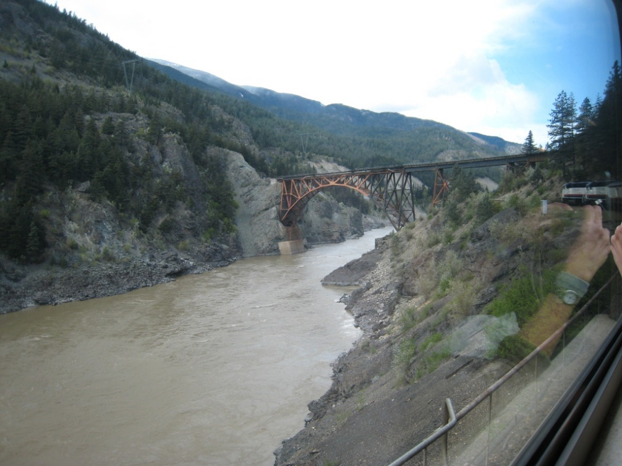
Trans Canadian Luxury Tour
10 nights/12 days
Departure cities
Toronto, ON
Ottawa, ON
Destination city – Vancouver, BC
Prices
$3560 – Toronto, ON
$3250 – Ottawa, ON

Slide 8
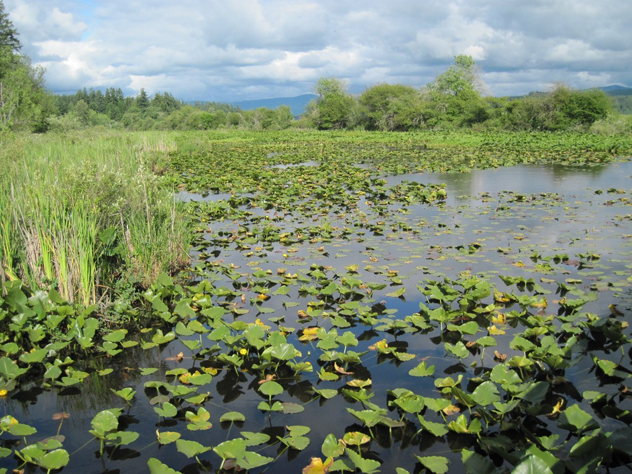
Manitoba Tour
3 nights/4 days
Departure city – Winnipeg, MN
Destination city – Churchill, MN
Prices
$380
Stops include The Pas and Pukatawagan

Slide 9
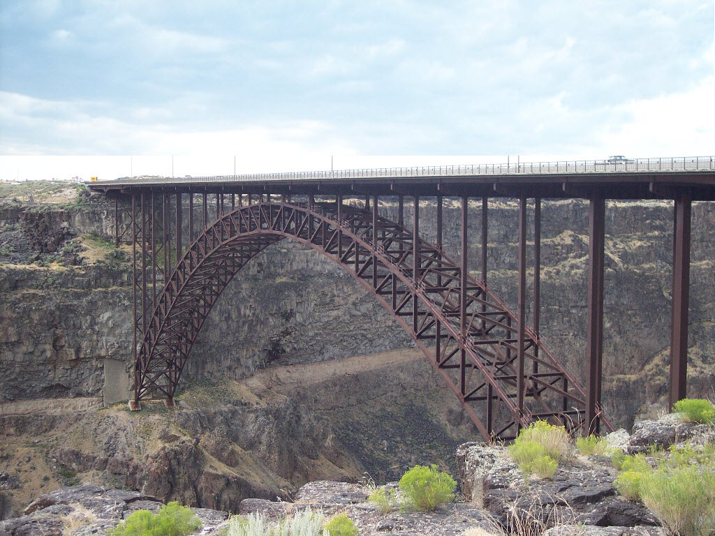
Explorer’s Trail West
Itinerary: Saskatoon – Edmonton
Route highlights
Western Development Museum
Wanuskewin Heritage Park
River Valley
Devonian Botanic Garden

Slide 10
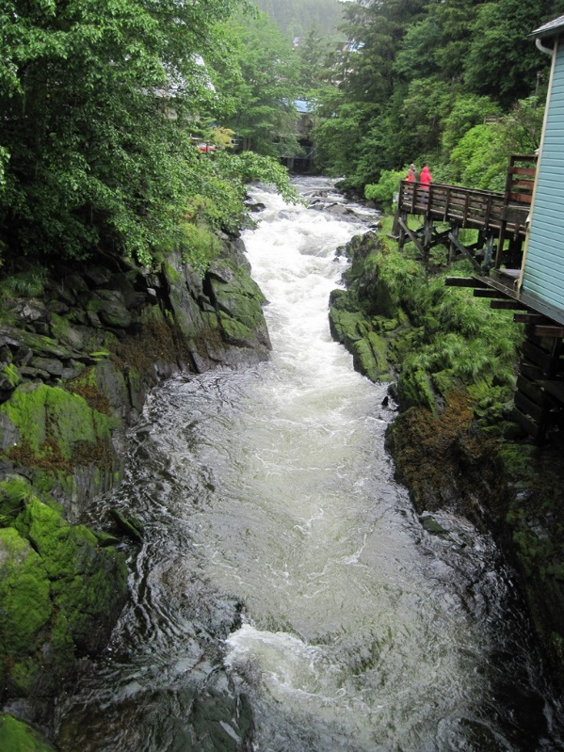
Western Pass
Itinerary: Jasper – Vancouver
Route highlights
Splendid views of the raging waters of Anderson Gorge
Tranquil beauty of Mount Robson – highest peak in the Canadian Rockies
Whitewater rafting on the Fraser River to Black Gulch

Slide 11
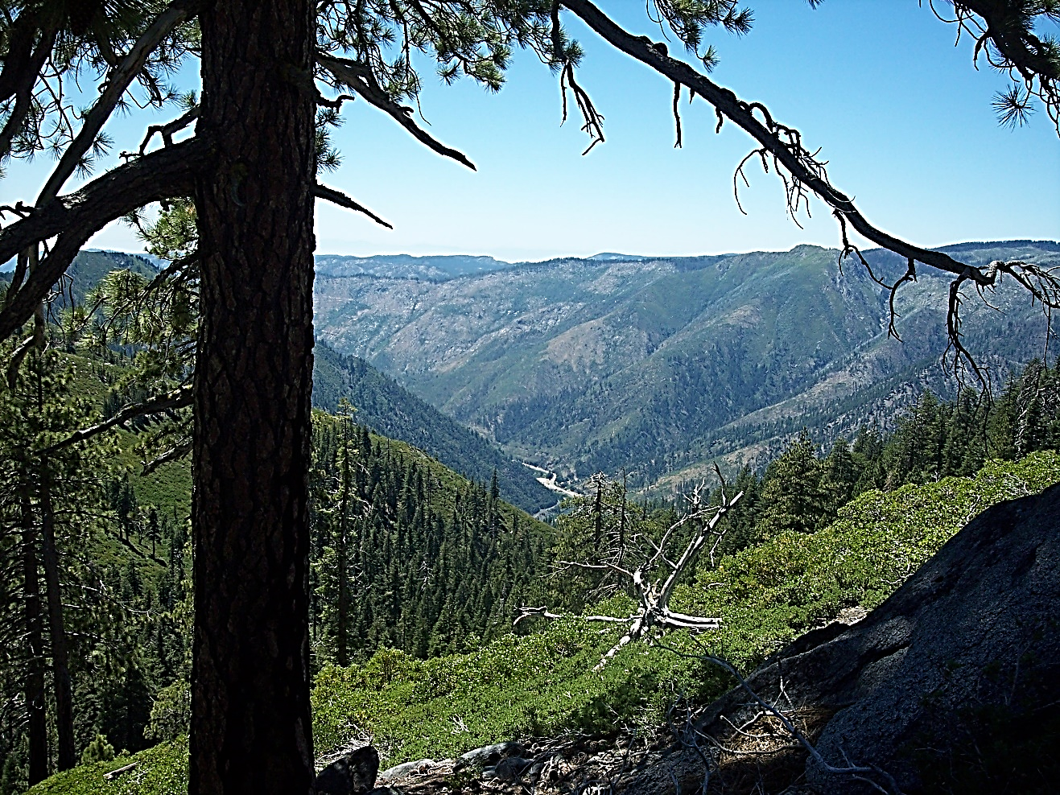
Magnificent Canadian Rockies
Jasper National Park
Maligne Valley - tranquil beauty set against rugged mountains
Experience the Athabasca Glacier
North Saskatchewan River Valley
Largest urban parkland in North America
Over 150 km of trails

Slide 12
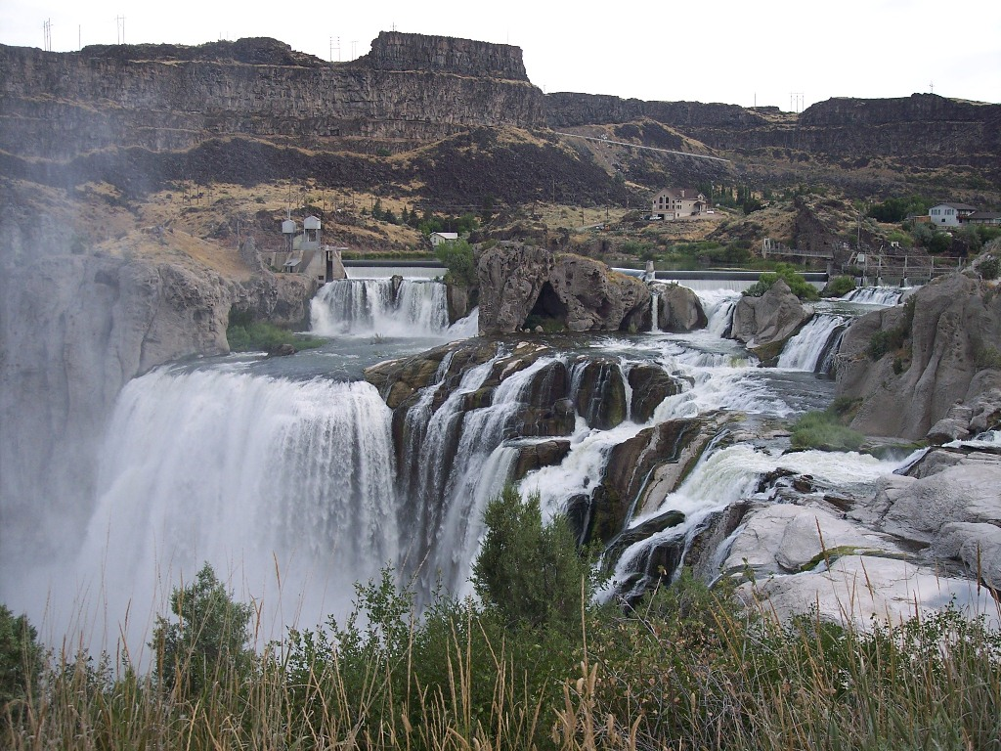
Coastal Route
Itinerary: Vancouver – Whistler
Route highlights
Natural beauty of the Coast Mountain Range
Spectacular views 320 feet high above Garibaldi Falls
Incredible lava flows and granite faces in Whistler Flats

Slide 13
Customer Survey
Notes:
Point out the rise in satisfaction on the food on the Pacific route

